Slide 1
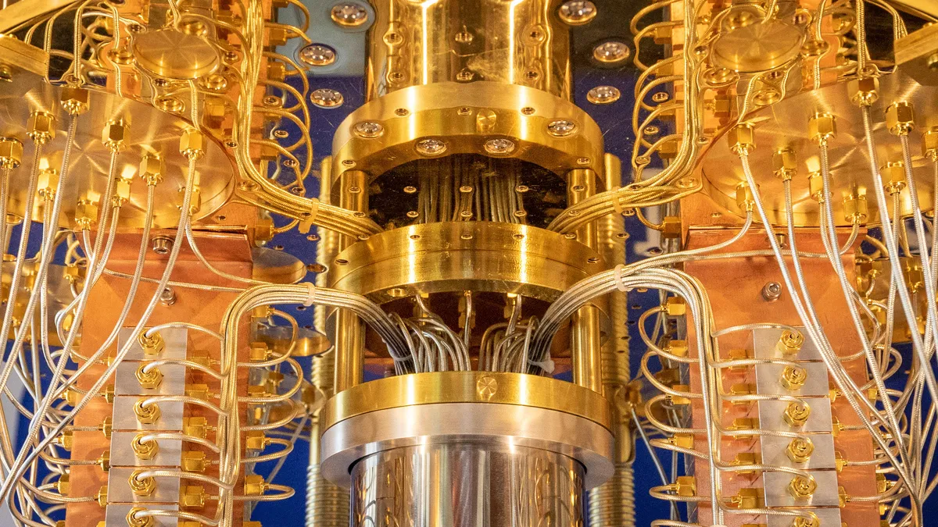
Quantum Cryptanalysis of OTR and OPP: Attacks on Confidentiality, and Key-Recovery
Authors: Melanie Jauch and Varun Maram
Presented by Andrea Basso
SAC’23, August 2023

Slide 2
Introduction
Quantum security: adversary has quantum access to secret-keyed encryption or decryption oracles.
In contrast to post-quantum security: adversary has quantum access to public oracles (e.g., hash functions).
In our setting, adversary can make encryption queries on a quantum superposition of messages.
Prior work: quantum superposition attacks by Kaplan et al. (Crypto 2016) on CBC-MAC, PMAC, GMAC, GCM, OCB, etc. breaking unforgeability (EUF-qCMA).
More recently: confidentiality (IND-qCPA) analysis of OCB modes by Maram et al. (ToSC 2022).
In this work, we focus on related authenticated encryption (AE) modes OPP and AES-OTR.
Notes:
Why are we interested in the Quantum Security of modes of operation in the first place?
Symmetric key setting: Impact of quantum computers has first been assumed to be less severe: Grovers algorithm let assume only quadratic speedup on symmetric primitives. (double key size enough?)
Soon realized that Not enough to consider security of standalone primitive (block cipher) but need to consider modes of operation aswell
Modes extend upon blockciphers: New possibilities to find vulnerabilities → that’s why we want to analyze quantum security of modes
Quantum Security: adversary has quantum access to secret keyed encryption or decryption oracles (post quantum: only public oracles e.g. hash functions) adversary can ask for the encryption of quantum states that are quantum superpositions of messages and receives superpositions of ciphertexts as an answer
Practicality of attack setting still debated but lead to interesting attacks: on CBC-MAC, PMAC, GMAC, GCM, and OCB breaking confidentiality (IND-qCPA) and unforgeability (EUF-qCMA)
In their analysis IND-CPA security and (E/U)UF-CMA security have been extended to a setting where the adversary is allowed to make quantum encryption queries
OCB Modes: Authenticated encryption modes, attacks extended upon the already existing analysis on quantum forgery attacks using Simon’s and Deutsch’s Algorithm
OPP and AES-OTR: two nonce based AEAD schemes related to the OCB modes (based on so called tweakable blockciphers)
AES-OTR: provable security in classical setting under the assumption that AES is a PRP – there exist already quantum forgery attacks
OPP tries to generalize OCB3 by replacing blockcipher with a public permutation and different form of masking

Slide 3
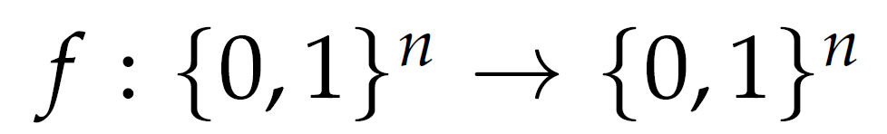

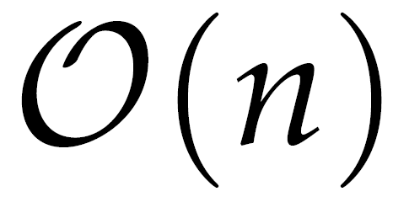
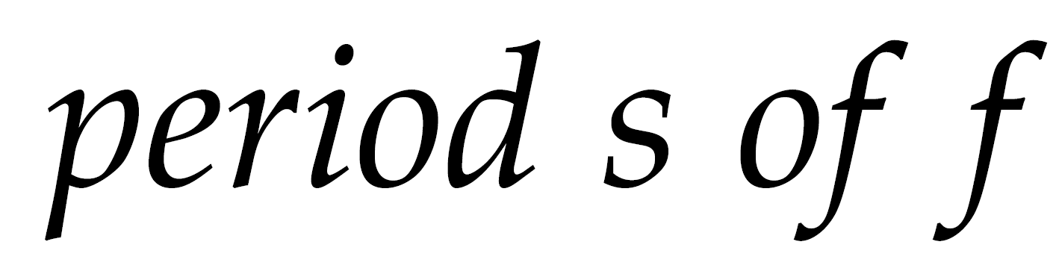
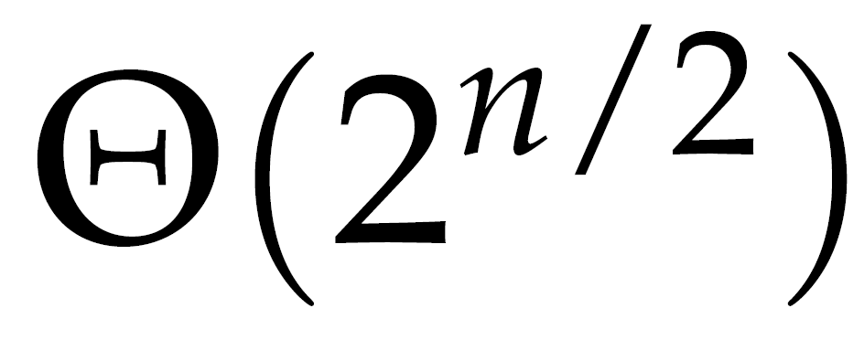
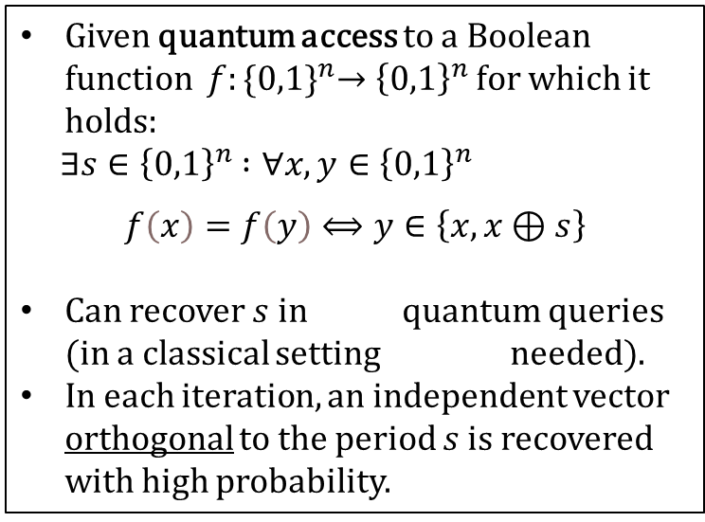
Simon’s Algorithm
Given quantum access to a Boolean function $f:{\{0,1\}}^{n}→{\left\{0,1\right\}}^{n}$ for which it holds$:$
$∃s∈{\left\{0,1\right\}}^{n}$ $:∀x,y∈{\left\{0,1\right\}}^{n}$
$$f\left(x\right)=f\left(y\right)⟺y∈\left\{x,x⊕s\right\}$$
Can recover $s$in quantum queries (in a classical setting needed).
In each iteration, an independent vector orthogonal to the period $s$ is recovered with high probability.
Simon’s Algorithm
Notes:
attacks fundamentally rely on well-known quantum algorithm: Simon’s period finding algorithm
We use the algorithm to gain raw blockcipher access in the case for AES-OTR and recover the key in the OPP setting

Slide 4
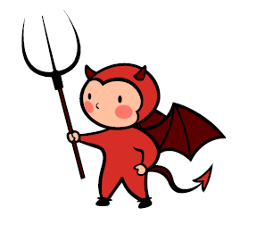
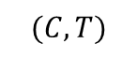

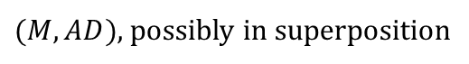
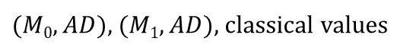

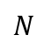
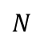

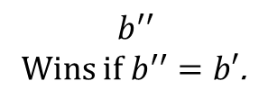



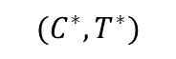
IND-qCPA Security Game
Adversary
Challenger
$b′$ $←$$ {0, 1}
$K←$KGen
------------------------------------
$$N$$
$N$ $←$$ $\{0,1\}κ$
Encryption Queries:
$(M, AD)$, possibly in superposition
$$(C, T)$$
$$(C,T)←{Enc}_{K}(N,AD,M)$$
(In any order)
$$N$$
$N$ $←$$ $\{0,1\}κ$
$(M0, AD)$, $(M1, AD)$, classical values
Challenge Query:
$$(C^{∗},T^{∗})$$
$(C^{∗},T^{∗})$ $←{Enc}_{K}(N,AD,M_{b′})$
$$b^{′′}$$
Wins if $b^{′′}=b′$.
Notes:
IND-qCPA security game. Important to notice that encryption queries can either be in superposition or not but the challenge query have to be classical values
Queries can be made in any order

Slide 5
Breaking AES-OTR‘s IND-qCPA Security
Notes:
AES-OTR emerged from the Offset Two-Round (OTR) mode [Min14] as a part of the CAESAR competition
Based on the AES block cipher
Nonce based (AEAD) scheme, two methods for associated data processing.
AES-OTR has a provable security in the classical setting under the assumption that AES is a pseudorandom function
Here we present IND-qCPA attack when AD is processed in serial
Uses observation from already existing EUF-qCMA attack on AES-OTR

Slide 6
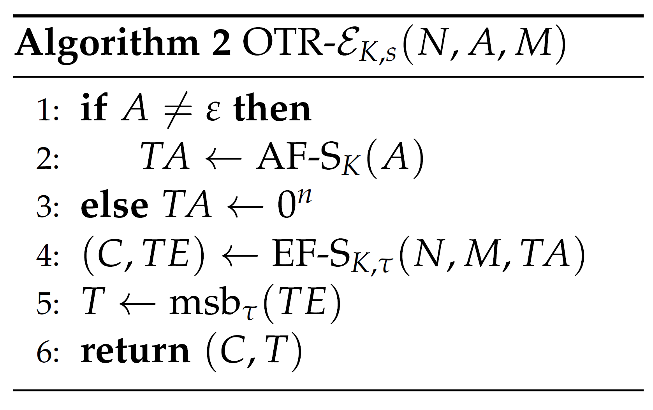
Specifications of AES-OTR
AD Processing
Notes:
Encryption algorithm of AES-OTR. Consists of an Authentication Core for AD processing and an Encryption Core
(tau is the length of the tag T)
Notice that AD can also be empty

Slide 7
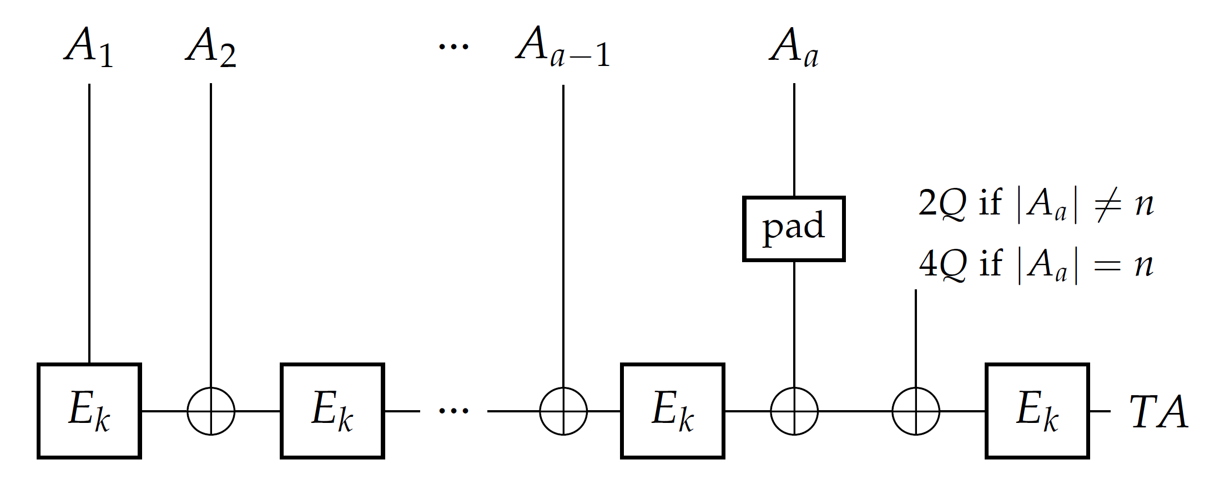
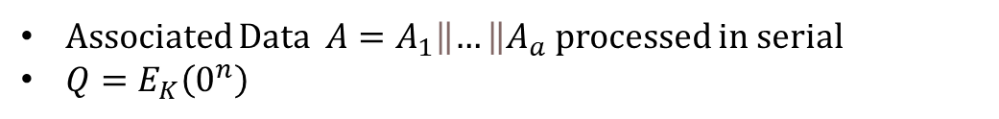
Specifications of AES-OTR: Authentication Core $AF$-$S_{K}(A)$
Associated Data $A=A_{1}\left\|…\right\|A_{a}$ processed in serial
$Q=E_{K}\left(0^{n}\right)$
Notes:
- If the last block of AD is not full, it is padded with 10* padding.

Slide 8
Specifications of AES-OTR
AD Processing
Encryption Core
Notes:
- Moving on to the encryption core that makes use of the value TA computed in the authentication core

Slide 9
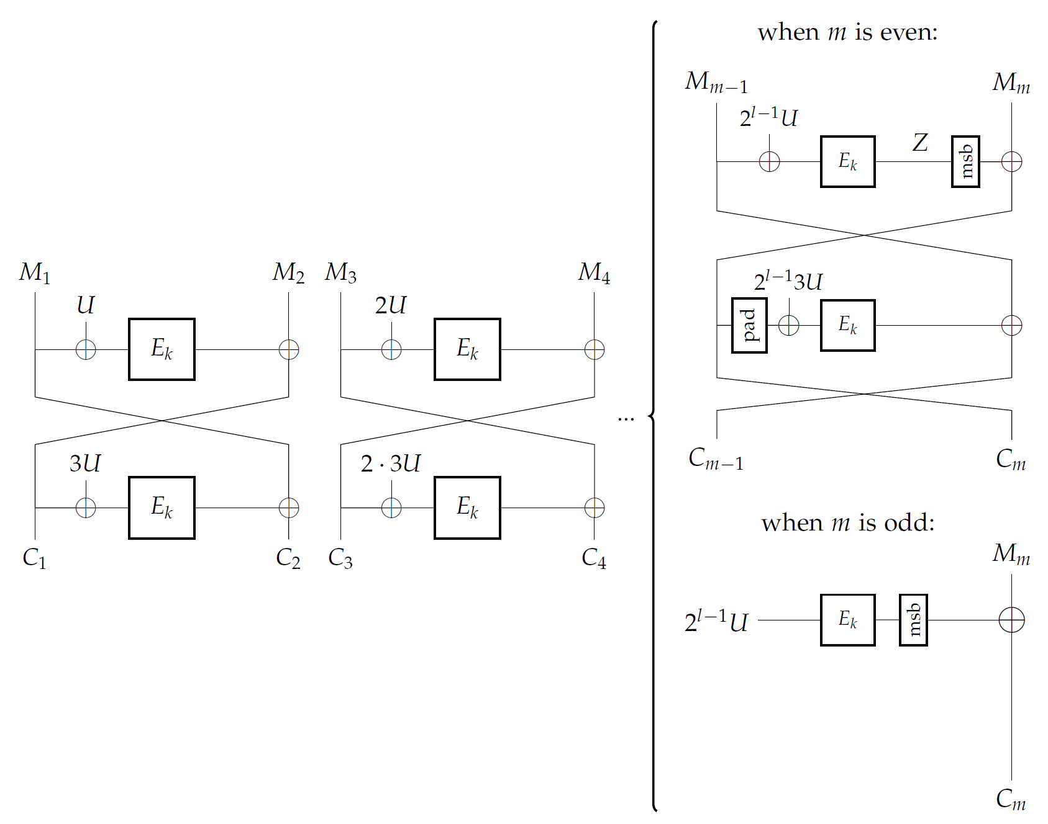
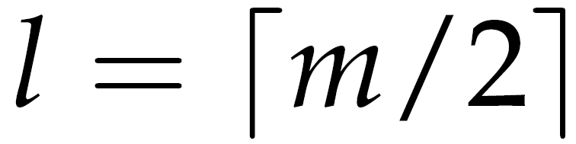
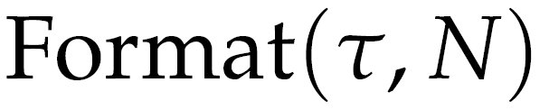
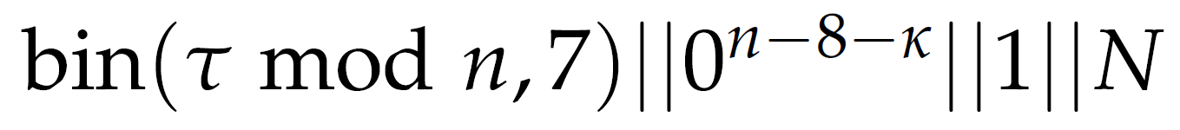
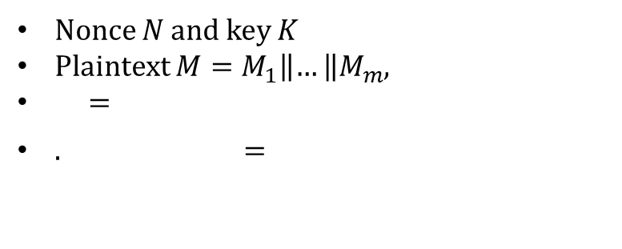
Specifications of AES-OTR: Encryption Core EF-$S_{K,τ}(N, M)$
Nonce $N$ and key $K$
Plaintext $M=M_{1}\left\|…\right\|M_{m}$,
=
. =
Notes:
We focus here on the case where we have an odd amount of plaintext blocks marked with blue box (no need to go over the encryption details)
For the IND-qCPA attack we will choose a single block plaintext
Notice that in this case we basically have one time bad encryption with key U.

Slide 10
Specifications of AES-OTR
AD Processing
Encryption Function
Tag Computation

Slide 11
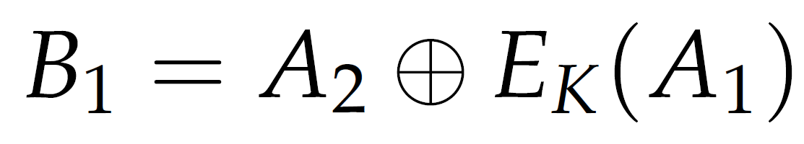
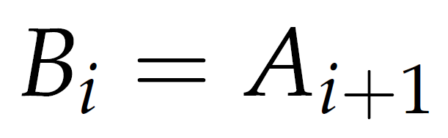
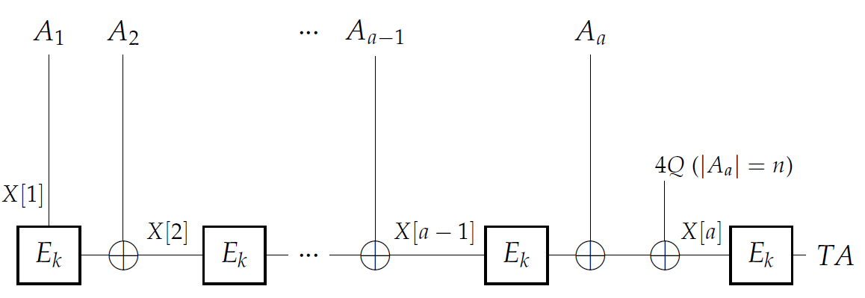

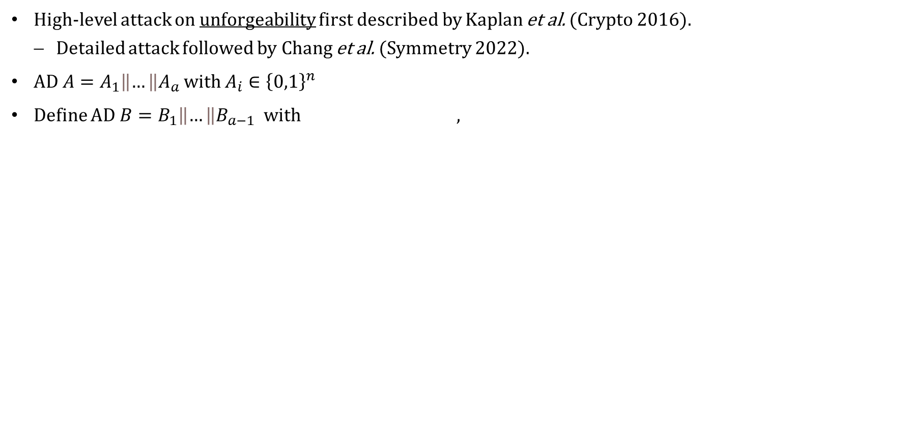


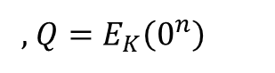

Finding Collisions in Serial AD Processing
High-level attack on unforgeability first described by Kaplan et al. (Crypto 2016).
Detailed attack followed by Chang et al. (Symmetry 2022).
AD $A=A_{1}\left\|…\right\|A_{a}$ with $A_{i}∈{\left\{0,1\right\}}^{n}$
Define AD $B=B_{1}\left\|…\right\|B_{a−1}$ with ,
$TAA=TAB$!
$${=:B}_{a−2}$$
$${=:B}_{a−1}$$
, $Q=E_{K}\left(0^{n}\right)$
$B_{1}$:=
Notes:
These observations are made in the classical setting!
The idea is to sum up two blocks of AD into one block in a way the algorithm would process the AD. So AD B is one block shorter.

Slide 12
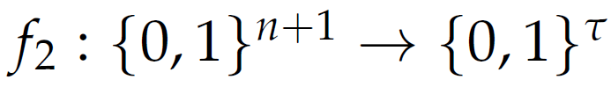
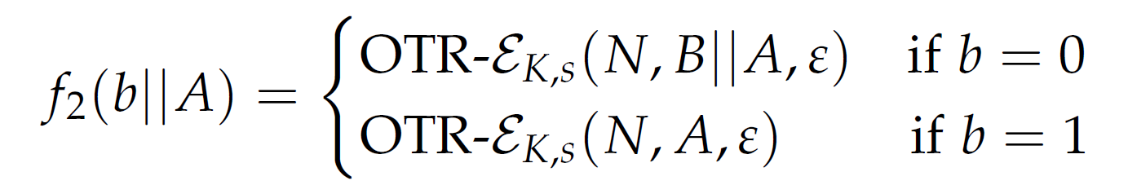
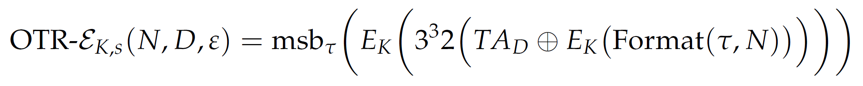
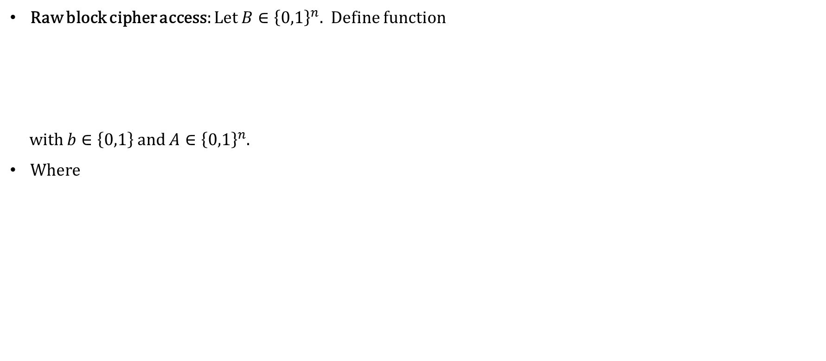

IND-qCPA Attack on AES-OTR with Serial AD Processing
Raw block cipher access: Let $B∈{\left\{0,1\right\}}^{n}.$Define function
with $b∈\left\{0,1\right\}$ and $A∈{\left\{0,1\right\}}^{n}$.
Where
depends on AD
Period of f₂ only depends on $TAD$!
Notes:
The aim is to gain raw block cipher access. To do so, we define function f2 that depending on an input bit b computes either the encryption of an input block of AD A or the encryption of AD B || A, where B is a fixed block of AD.
Note that here f2 gives us a value in {0, 1}^τ, namely the tag T, since the ciphertext is empty as a result of the plaintext being chosen as empty.
TA is computed as described before.

Slide 13
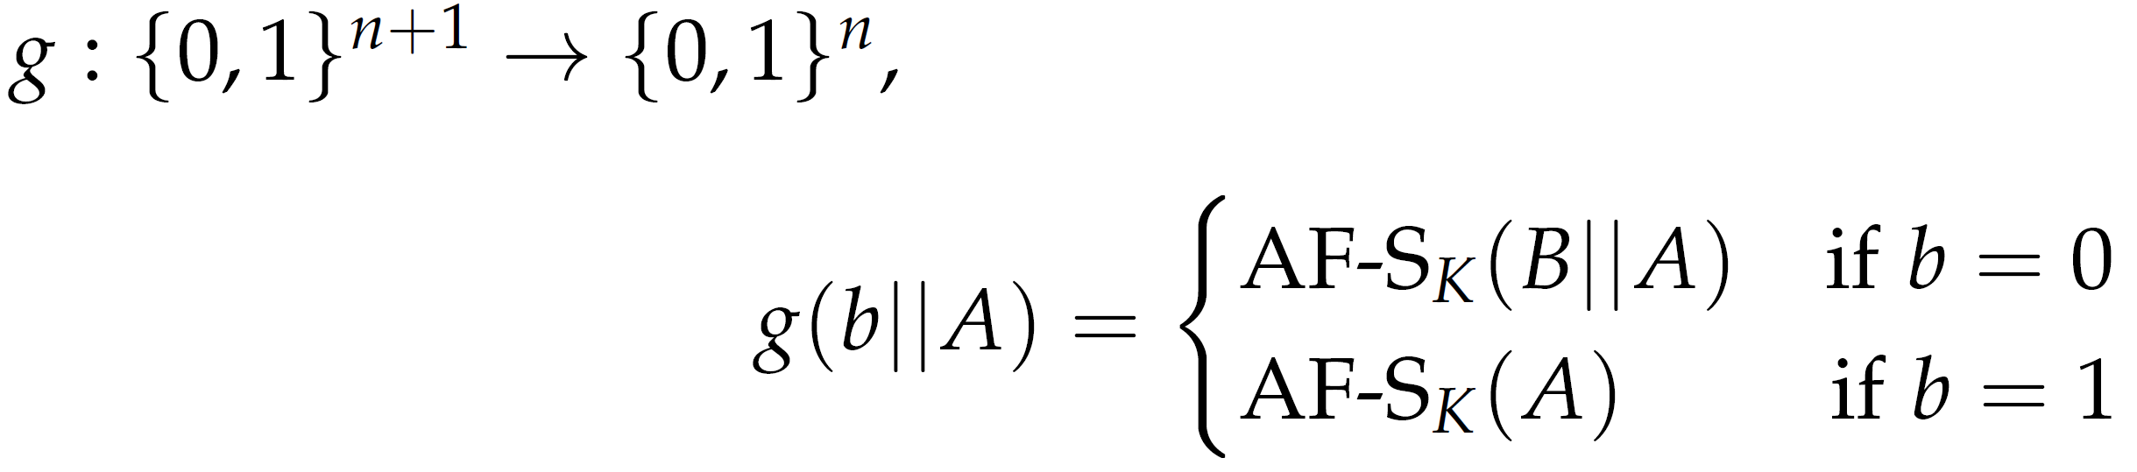
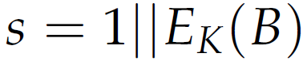
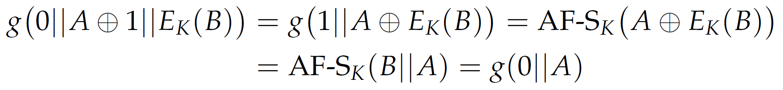
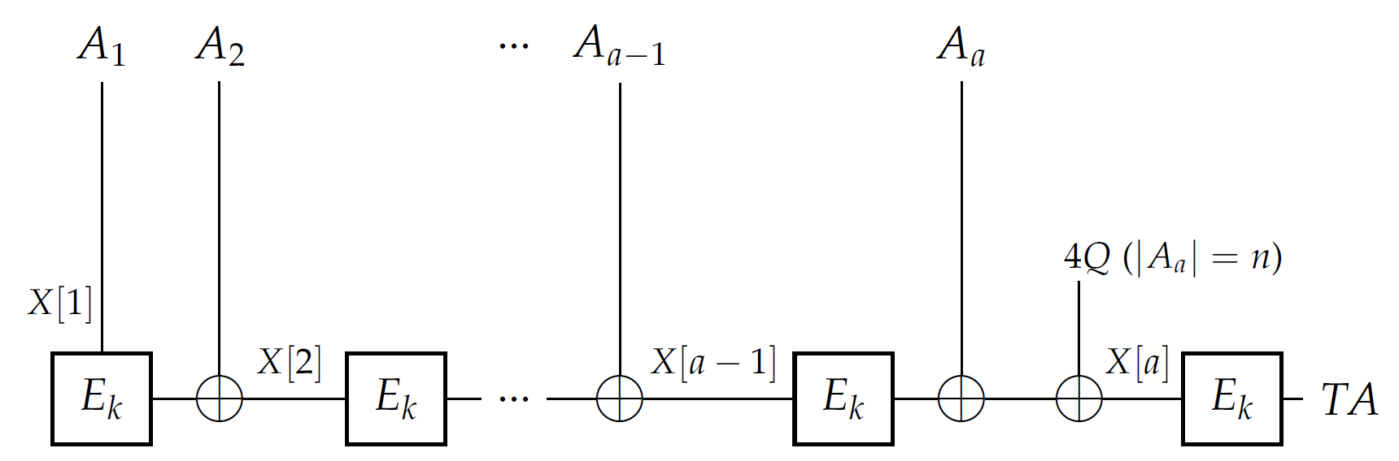
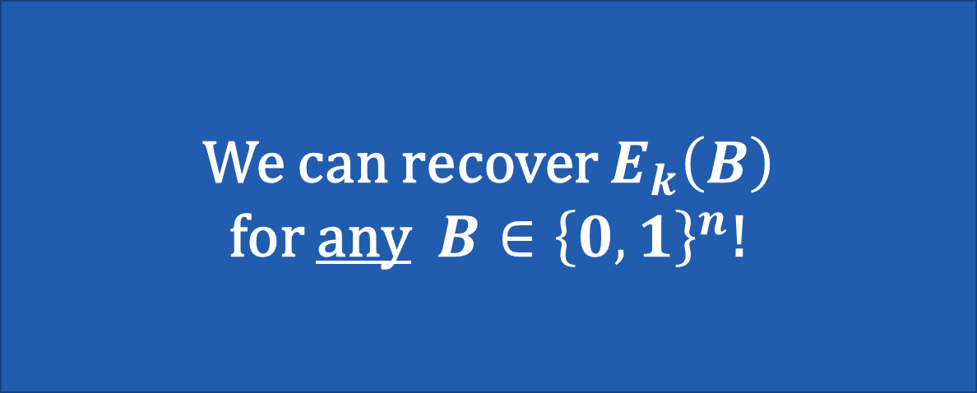
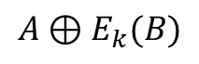
IND-qCPA Attack on AES-OTR with Serial AD Processing
Define new function (inner function of f₂)
Claim: g (and thus also f₂) has period :
We can recover $E_{k}\left(B\right)$
for any $B∈{\left\{0,1\right\}}^{n}$!
$A⊕E_{k}(B)$
B
A
Notes:
For simplicity, we define an inner function of f_2, namely the computation of the TA value
We claim and prove periodicity, here shown for input 0 || A, works the same for 1||A, but E_K(B) cancels out due to xor.
With the assumption that we can in fact compute f2 in superposition using a single quantum query to the encryption oracle OTR-EK,s(N, ・)
Recover EK(B) in O(n) quantum queries using Simon’s algorithm
period s is independent of the nonce. even though nonce, and hence f2 changes with each quantum query, Simon’s algorithm still returns random vector orthogonal to fixed period s = 1||EK(B) in each of the n iterations. -> solve system of linear equations
As a result we gain raw block cipher access!

Slide 14
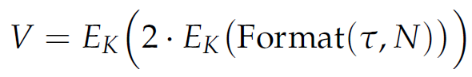
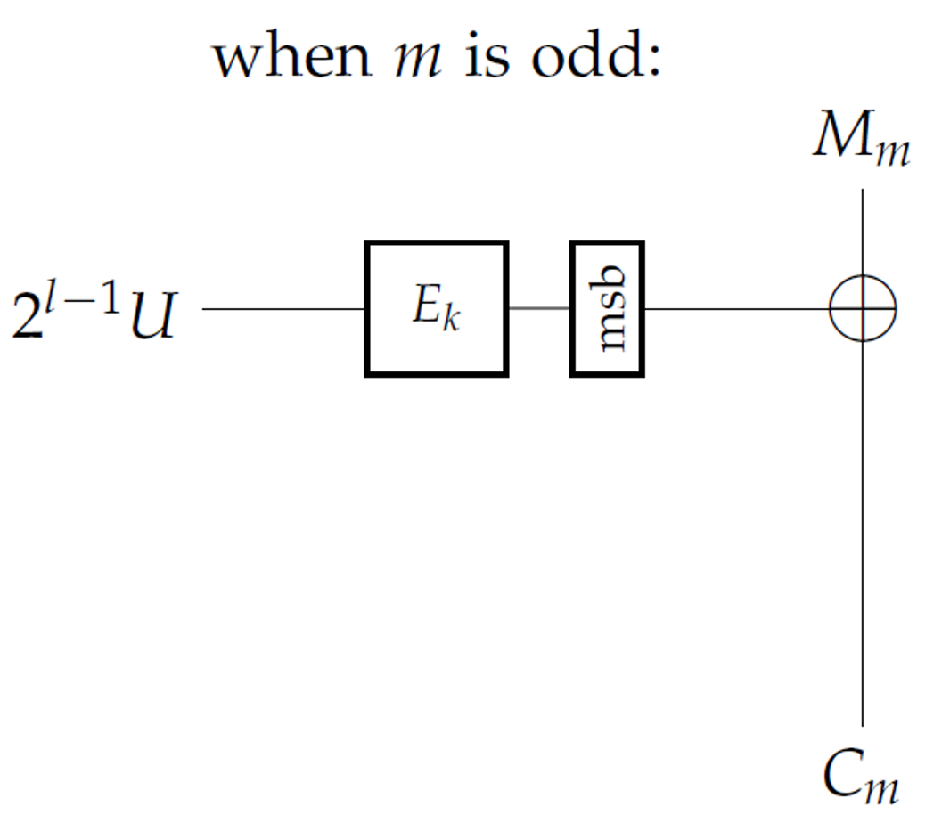
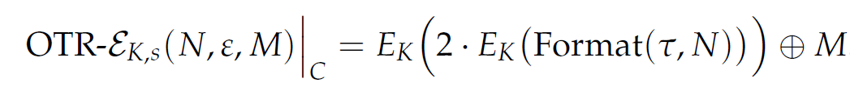
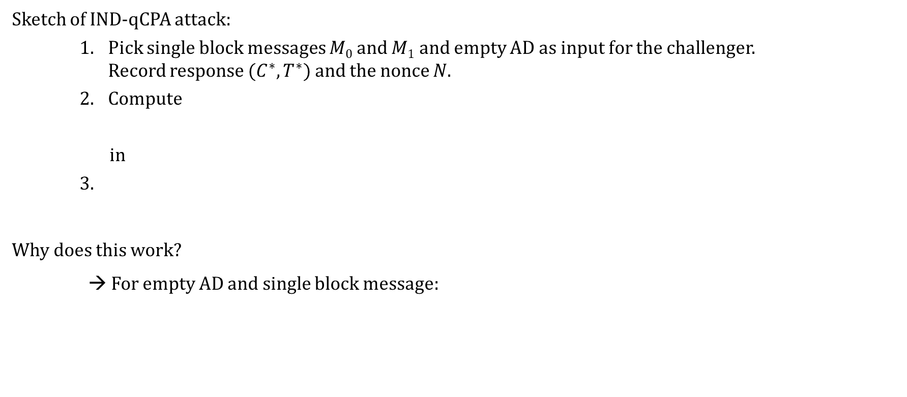
IND-qCPA Attack on AES-OTR with Serial AD Processing
Sketch of IND-qCPA attack:
Pick single block messages $M0$ and $M1$ and empty AD as input for the challenger. Record response $(C^{∗}, T^{∗})$and the nonce $N$.
Compute
in
3.
Why does this work?
→ For empty AD and single block message:
2
=
Notes:
Challenger returns the nonce used to encrypt either M0 or M1.
About Step 2.: We can do this via using the raw block cipher access twice as discussed before
Recall that for empty AD and a single block message, AES-OTR performs one time pad encryption with offset V which we are able to recompute.

Slide 15
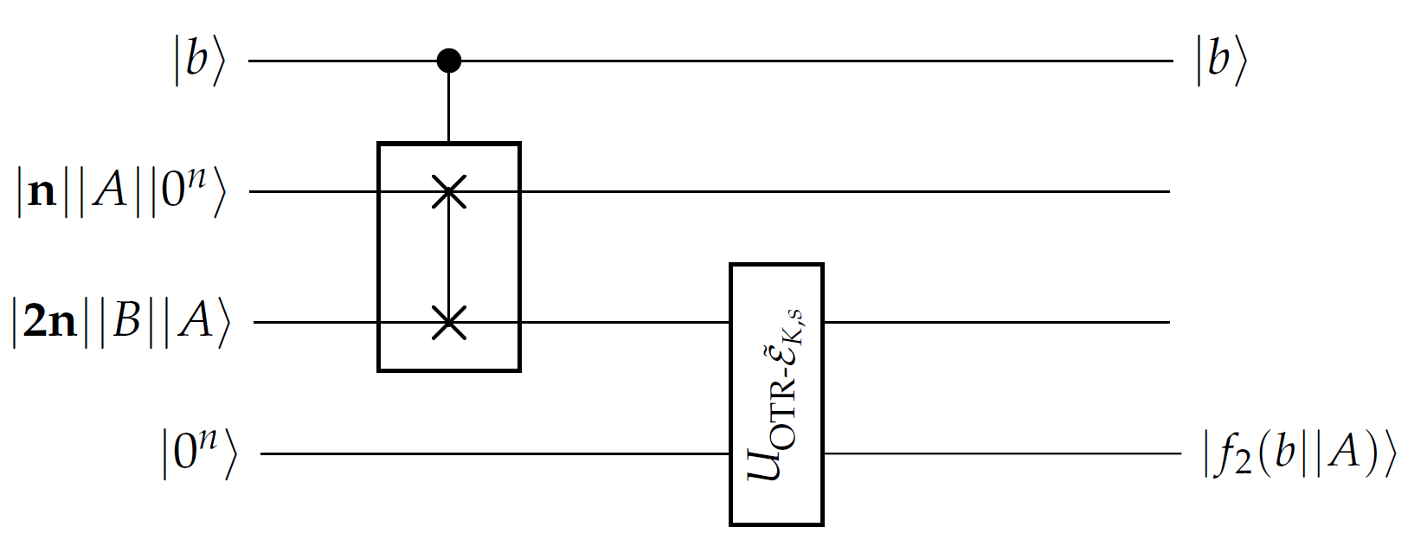
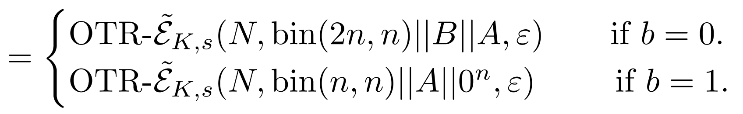
Superposition Over Unequal-Length Data
We need to have quantum access to f₂ with a single query to the encryption oracle!
Controlled SWAP
Modified encryption oracle with controlled input size
Notes:
We need to have quantum access in a single query to the oracle, because else f_2 wouldn’t be periodic anymore (e.g. two queries would imply usage of two distinct nonces)
Design a Quantum Circuit
to modify the quantum encryption oracle queries in a slight way: we add an additional n-qubit input register which encodes the length of our message
Modified quantum encryption oracle: the encryption oracle knows how many bits of the message it should actually encrypt by paring the first n qubits
Controlled Swap: gate essentially swaps the inputs when b = 1 and does nothing if b = 0. (have to be of the same input size, here 3n qubits)
We have superpositions over unequal length messages!
to the best of our knowledge, such an idea was never used before in the quantum cryptanalysis literature -- i.e., prior attacks always used superposition over equal length messages

Slide 16
Superposition Over Unequal-Length Data
Laws of quantum physics define a superposition only over states with the same number of qubits.
We can overcome this restriction in the IND-qCPA setting with this modified quantum encryption oracle!
Allows for stronger quantum attacks: e.g., we gain raw block cipher access directly via Simon’s algorithm.
This contrasts with the IND-qCPA attacks against OCB by Maram et al. (ToSC 2022) which also requires Deutsch’s algorithm, along with Simon’s algorithm.
This model can also be extended to cryptanalysis in the more realistic post-quantum setting – e.g., attacking (public) hash functions.
Notes:
- novel paradigm which, to the best of our knowledge, has never been considered in the (post-)quantum cryptanalytic literature
- seemingly implicit restriction of an adversary only being able to make superposition queries over equal-length data
- For the post-quantum setting: the adversary has quantum access only to public cryptographic oracles (also called “Q1 security” in the literature) such as hash functions in the so-called Quantum Random Oracle Model (QROM).

Slide 17
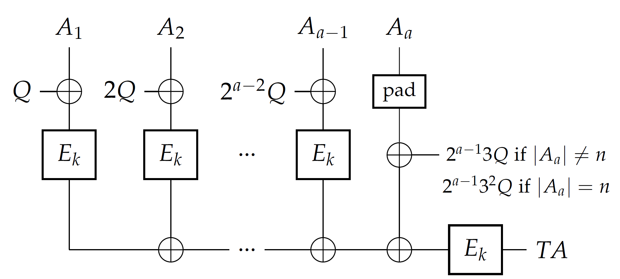
Further Attacks on AES-OTR
IND-qCPA attack when AD is processed in parallel.
IND-qCPA attack when AD is always empty.
AD processed in parallel
Notes:
When AD is processed in parallel, we need additionally Deutsch’s Algorithm to get raw blockcipher access. But there we also rely on finding collisions in AD in a similar fashion as for the serial case
When AD is empty we can’t rely on finding collisions of AD. We need a weaker attack setting where nonces are picked adaptively but we then are able to break IND-qCPA once again.
(no need to explain how parallel processing works)

Slide 18
Quantum Key-Recovery Attack on OPP
Notes:
About OPP:
essentially tries to generalize OCB3 by replacing the underlying block cipher by a public permutation and a different form of masking
Permutation can be inverted efficiently
Assume always plaintexts of a size that is a multiple of the block length

Slide 19
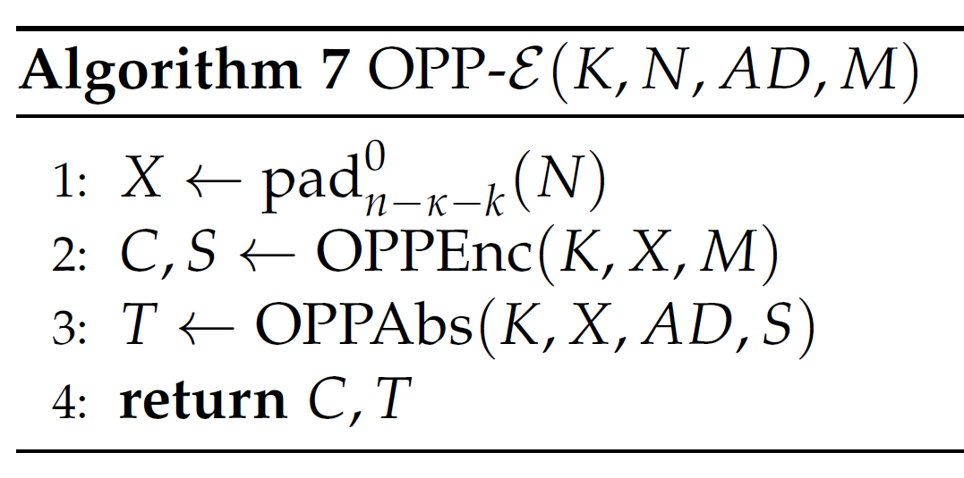
Specifications of OPP (simplified)
Offset Public Permutation Mode
Zero padding
Encryption Core
Authentication Core
(not relevant for the attack)
Notes:
Encryption Algorithm of OPP with an encryption and authentication core.
The padding function fills up the block with all 0.

Slide 20
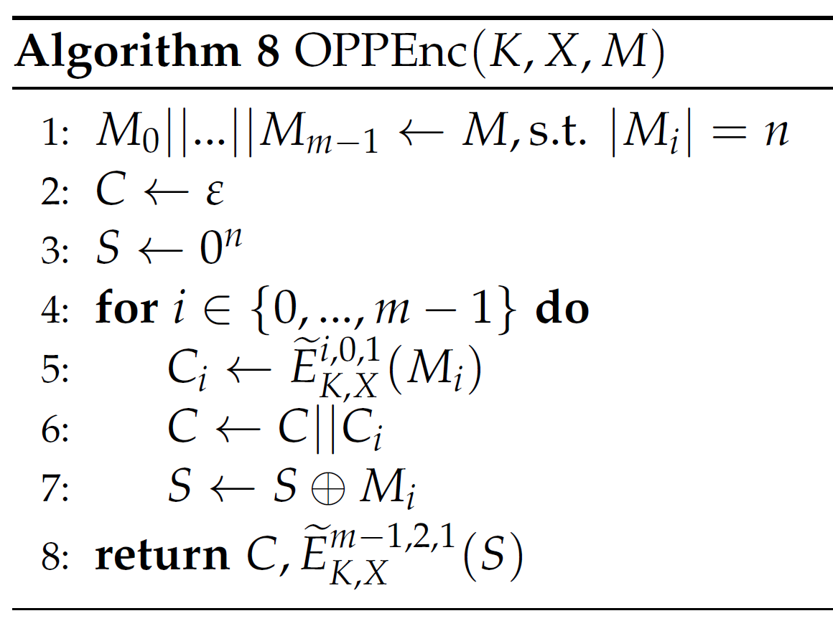

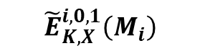
Specifications of OPP: Encryption Core $OPPEnc\left(K,X,M\right)$
$${\tilde{E}}_{K,X}^{i,0,1}\left(M_{i}\right)$$
Checksum: Xor of all plaintext blocks
Notes:
Encryption core makes use of so called tweakable block cipher, which uses a set of 3 indices.

Slide 21
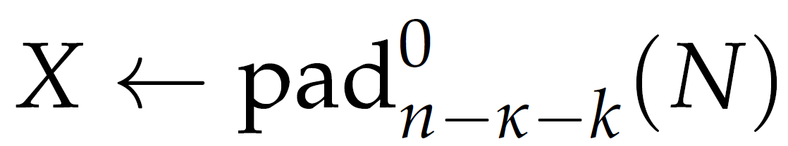
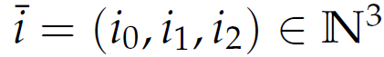
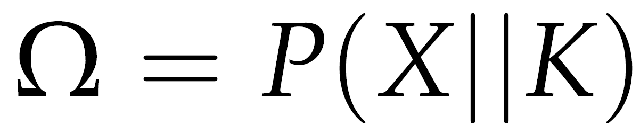

What is ${\tilde{E}}_{K,X}^{i,0,1}\left(M_{i}\right)$?
=
Key
$β(x)=φ(x)⊕x$
β(x)=𝜑(𝑥)⊕𝑥
$α(x)=φ(x)$
α(𝑥)=𝜑(𝑥)
$γ\left(x\right)=φ^{2}(x)⊕φ(x)⊕x$
𝛾(𝑥)=𝜑^2 (𝑥)⊕𝜑(𝑥)⊕𝑥
$γ^{i_{2}}$ $∘β^{i_{1}}∘α^{i_{0}}(P(X∥K))$
𝛾^(𝑖_2 ) ∘𝛽^(𝑖_1 )∘𝛼^(𝑖_0 ) (𝑃(𝑋∥𝐾))
$φ\left(x\right)=Mx, M$ a matrix
Notes:
i.e. phi is a linear function (invertible)
Delta is the composition of alpha, beta, and gamma with exponents given by the three indices.

Slide 22




Quantum Key-Recovery Attack on OPP: Preparation
Ciphertext block as a function of its corresponding plaintext block:
with and
Observe for :
What if we can recover
$Ω=P\left(X||K\right)$?
i
i
i
Notes:
If we recover Omega, we can apply the inverse of P (since it is an invertible public permutation) and thus recover the key K.
But how do we do that? We take xors of two consecutive ciphertext blocks and notice that this is periodic.

Slide 23





Quantum Key-Recovery Attack on OPP
Idea: (By Bhaumik et al. (Asiacrypt 2021)) Create periodic function that contains $n$ copies of the earlier periodic function in the linear function
Using g, define such that
has $n$ linearly independent periods
Notes:
Why all this with n periods in one function? Notice that the period is dependent on the nonce N, so we cannot recover it using n iterations of simon’s algorithm as the nonce changes with each iteration. So we need to make one big query to avoid changing nonces.
Notice the first plaintext block is the fixed all zeros vector. we recover the fixed classical value of the first ciphertext block C0 when we measure the quantum register corresponding to the output of f_N as part of our application of Simon’s algorithm
Using this value, we can perform a sanity check of the key by computing the encryption of 0^n and comparing it with C0.
F_N is periodic: This directly follows from the observation on the periodicity we made before and the fact that each pair of the two consecutive ciphertext blocks C2i−1 and C2i for i ∈ [n] encrypt the same plaintext block Mi but with different mask δ

Slide 24





Quantum Key-Recovery Attack on OPP
Apply Simon’s algorithm and recover orthogonal to each of the periods with a single quantum query.
We get $n$ linear equations:
which we are able to solve for $Ω=P\left(X||K\right).$
$P$ is a public, efficiently invertible permutation!
We recover the key!
$$⇔$$
Notes:
We are able to compute fN because we can compute linear functions of a quantum oracles output
No unwanted periods: they would need to occur with prob > 0.5 which imples that the inner func would have unwanted period with prob >1/2n, but there are no higher order differentials for the inner functions (so called MEM)
Notice that we do not need to know the underlying nonce.

Slide 25

For questions, please reach out to the authors:
Melanie Jauch – mjauch@student.ethz.ch
Varun Maram – vmaram@inf.ethz.ch

Slide 26


Extra Slide
Periodicity of f₂:
f₂ is not periodic when computed with two quantum encryption queries:

